Slide 1
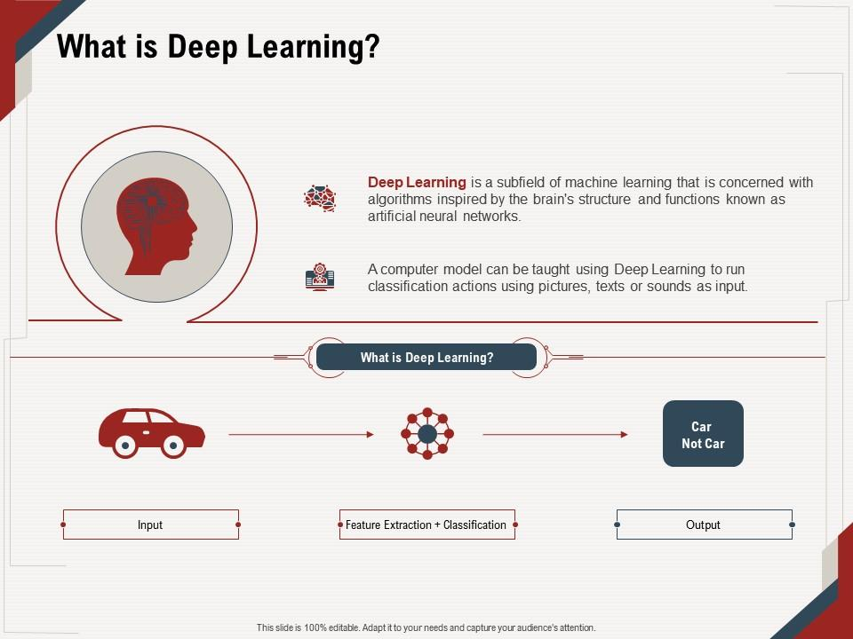

Slide 2
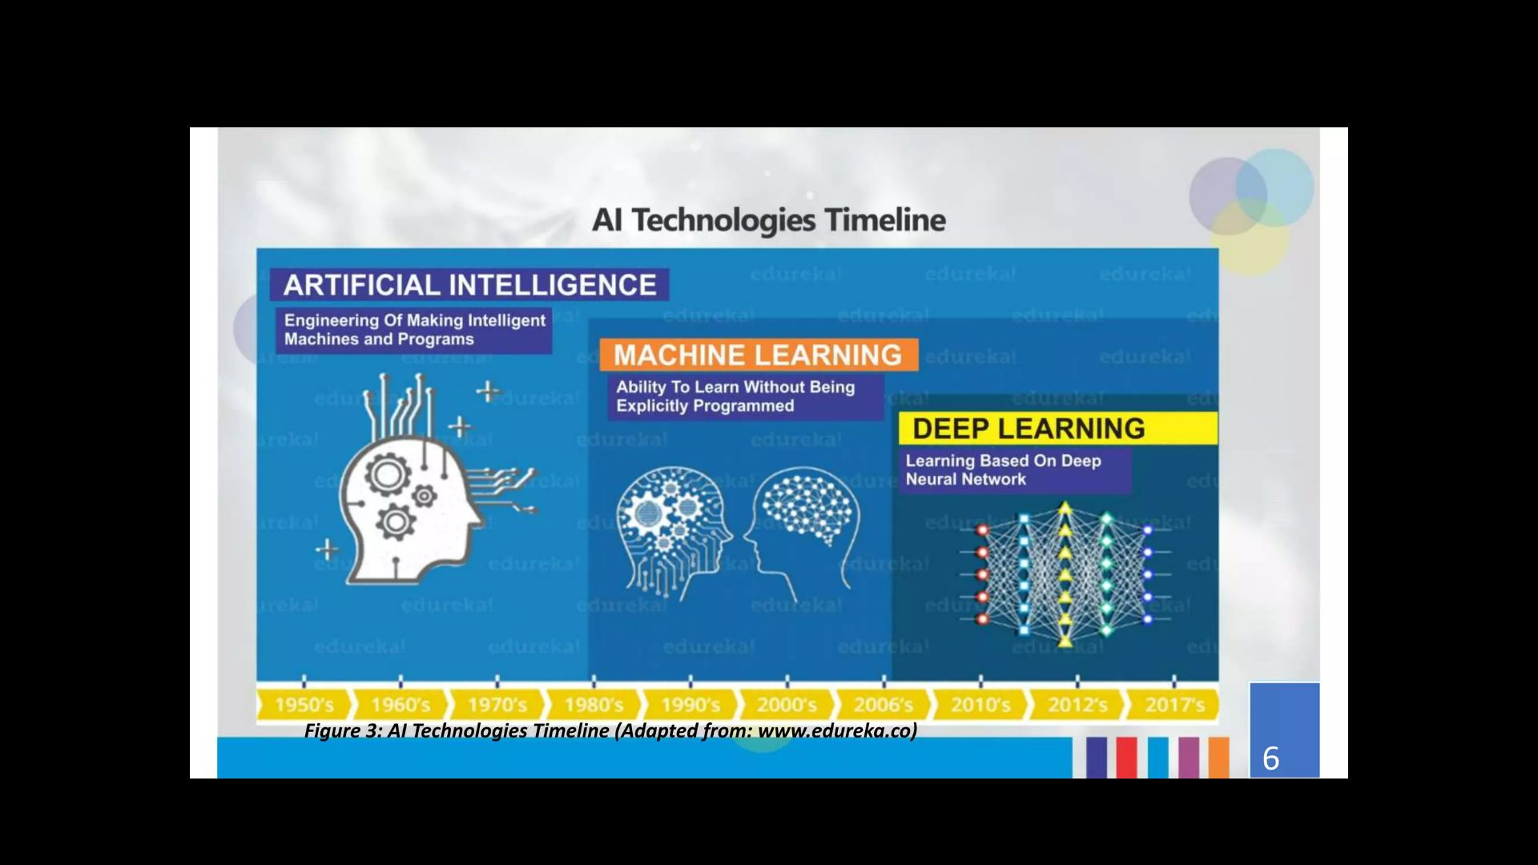
AI Technologies Timeline

Slide 3
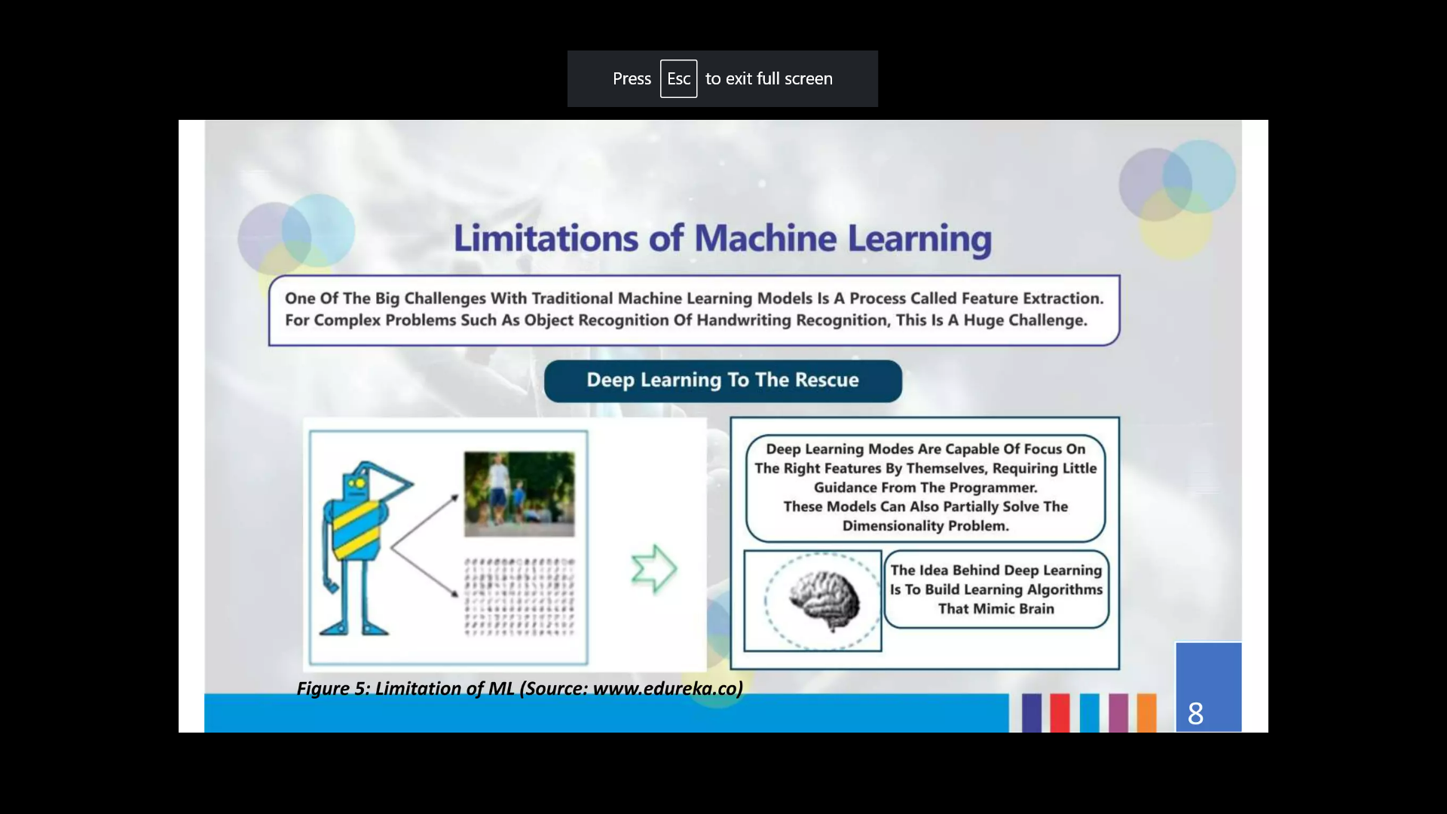
Limitation of Machine learning

Slide 5
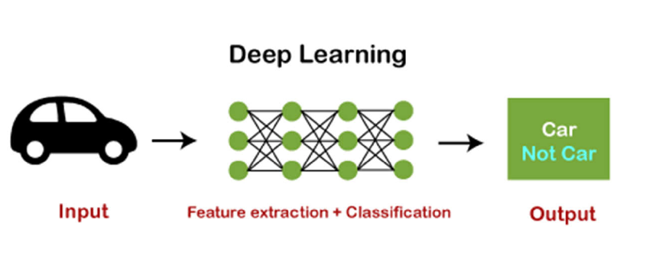
How Deep Learning Works?
The deep learning model takes the images as the input and feeds them directly to the algorithms
without requiring any manual feature extraction step. The images pass to the different layers of the
artificial neural network and predict the final output

Slide 6
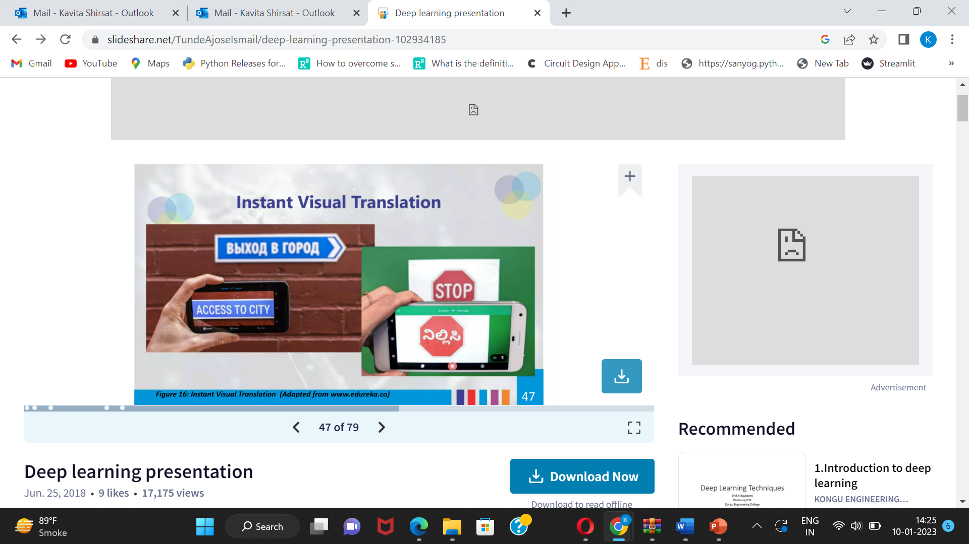
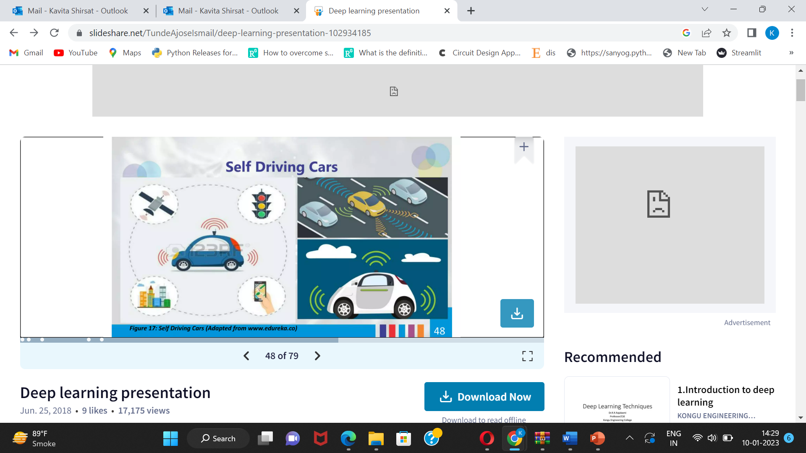
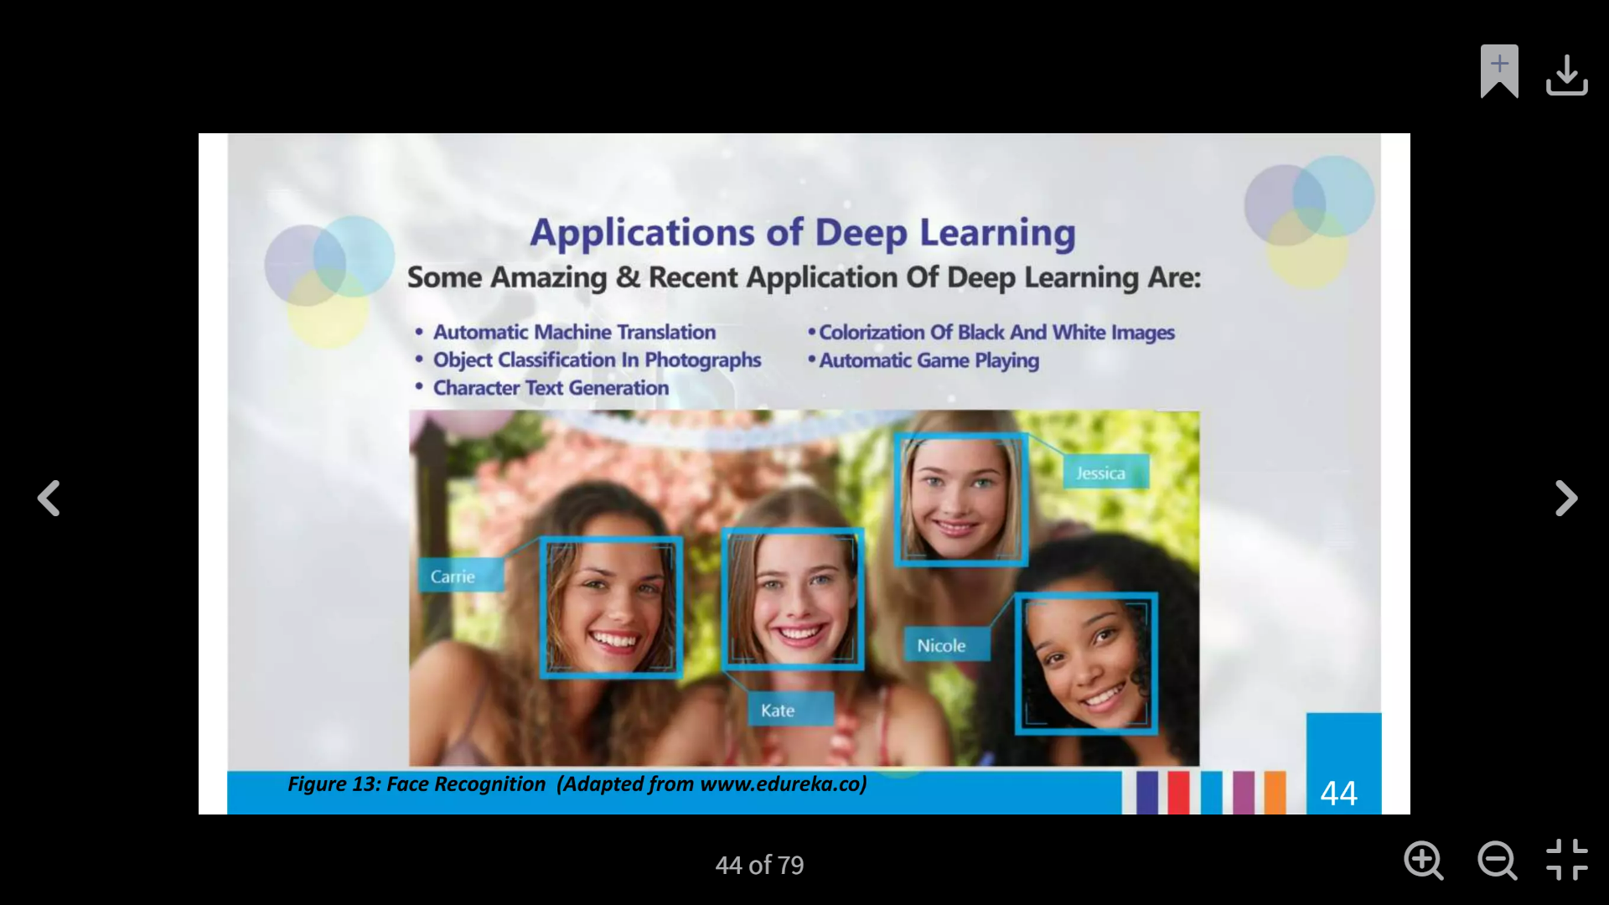
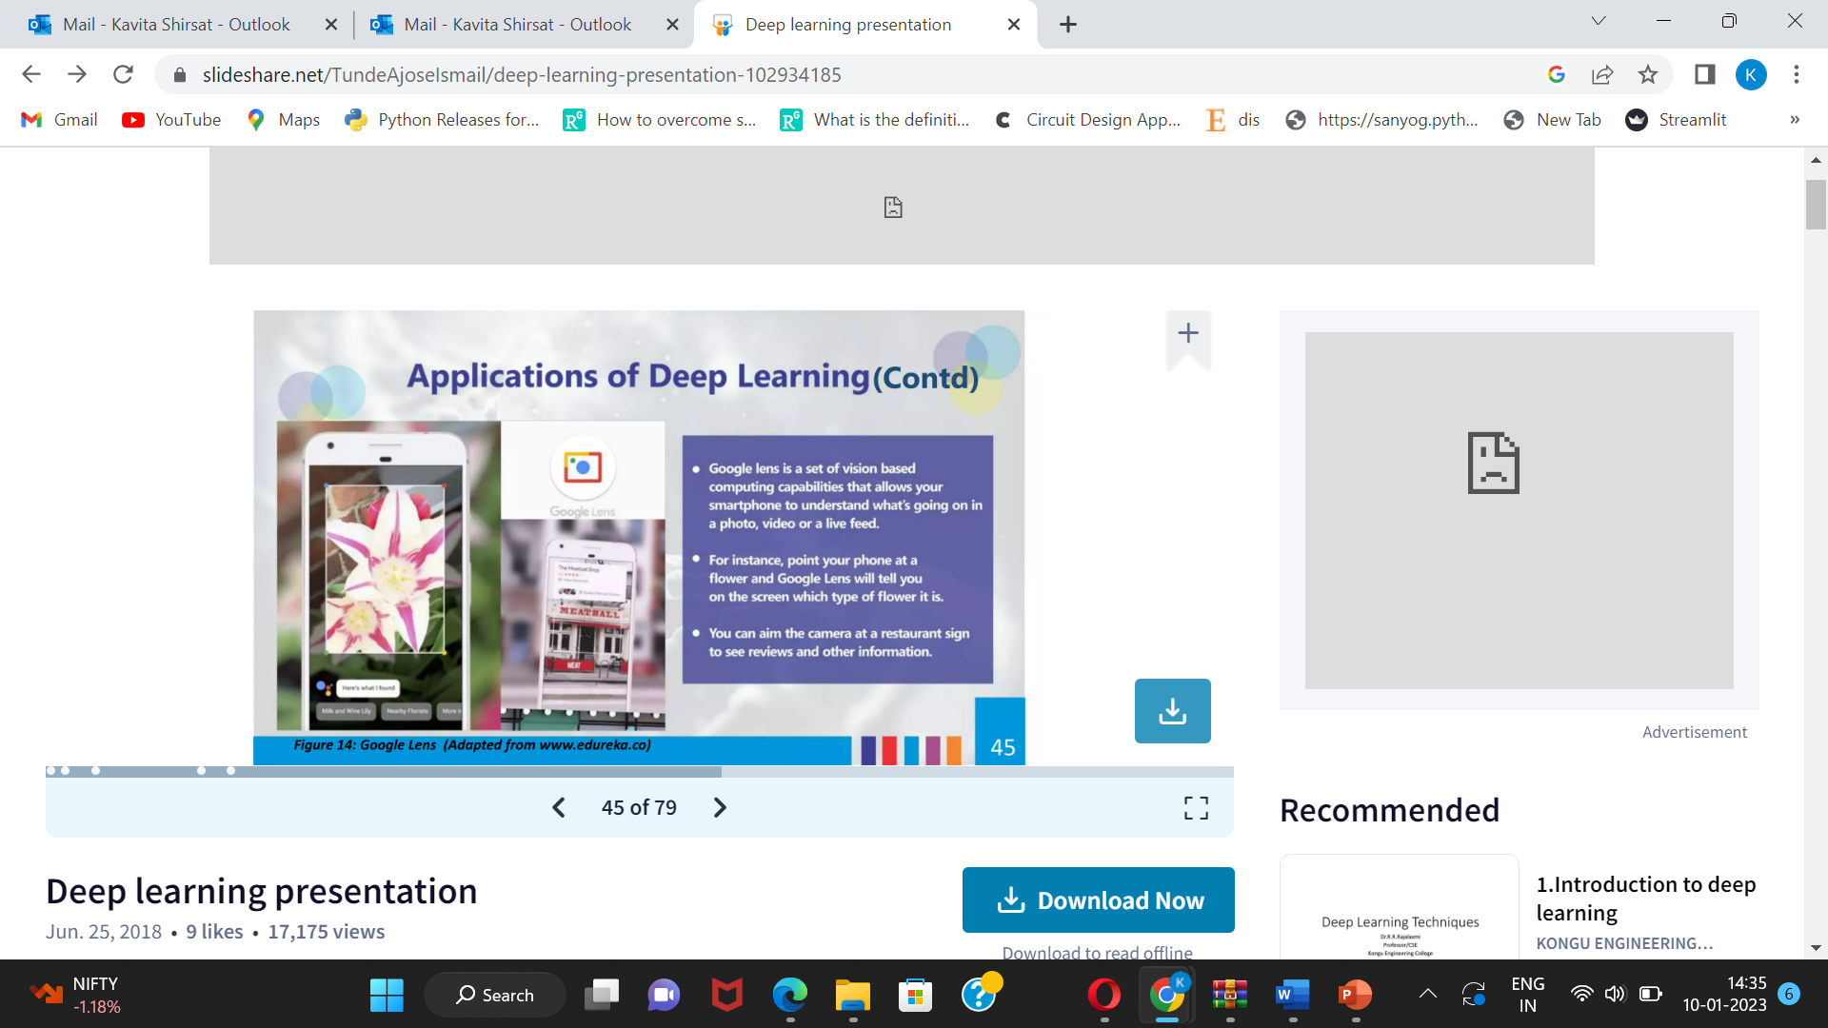
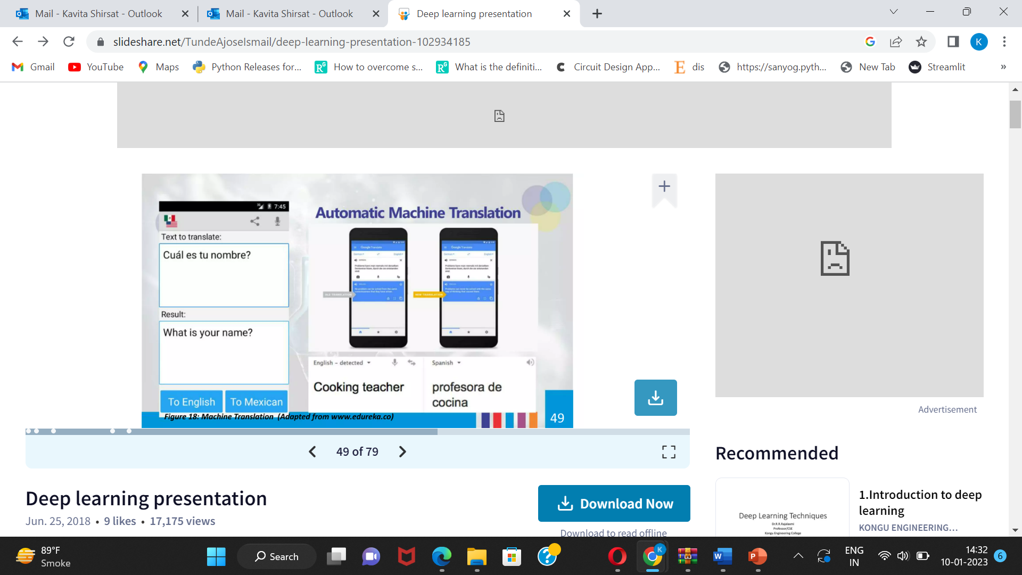
Some Amazing Applications of Deep Learning
Instant Visual Translation
Self Driving Car
Automatic Machine translation
Object Classification in photographs
Automatic Game Playing
Colourization in black and white images
Google Lens
Automatic Machine Translation

